Slide 1
Revision of Area
How do I calculate the area of composite shapes?

Slide 2
Learning Objectives
Revise units of length and area
Use formulas to find the area of basic shapes
Calculate the area of composite shapes.

Slide 3
Task
Quickwrite – What do I know about area and perimeter?

Slide 4

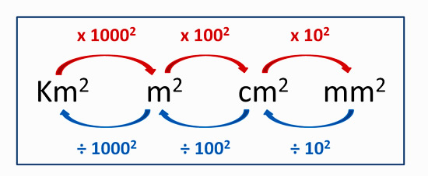

Revision of Area EQ- How do I calculate the area of composite shapes?
How do I convert units of length?
How do I convert units of area?
10 000$m^{2}$ = 1Hectare (ha)

Slide 5
Task – Name the shape and match up the formula

Slide 6
Revision of Area EQ- How do I calculate the area of composite shapes?
How do I find the area of a composite shape?

